Slide 1
Complexity Analysis

Slide 2
Complexity
A measure of the performance of an algorithm
An algorithm’s performance depends on
  internal factors
  external factors

Slide 3
External Factors
Speed of the computer on which it is run
Quality of the compiler
Size of the input to the algorithm

Slide 4
Internal Factor
The algorithm’s efficiency, in terms of:
Time required to run
Space (memory storage) required to run
Note:
Complexity measures the internal factors (usually more interested in time than space)

Slide 5
Need for analysis
To determine resource consumption
  CPU time
  Memory space
Compare different methods for solving the same problem before actually implementing them and running the programs.
To find an efficient algorithm

Slide 6
Two ways of finding complexity
Experimental study
Theoretical Analysis

Slide 7
Experimental study
Write a program implementing the algorithm
Run the program with inputs of varying size and composition
Get an accurate measure of the actual running time
Plot the results

Slide 8
Limitations of Experiments
It is necessary to implement the algorithm, which may be difficult
Results may not be indicative of the running time on other inputs not included in the experiment.
In order to compare two algorithms, the same hardware and software environments must be used
Experimental data though important is not sufficient

Slide 9
Theoretical Analysis
Uses a high-level description of the algorithm instead of an implementation
Characterizes running time as a function of the input size, n.
Takes into account all possible inputs
Allows us to evaluate the speed of an algorithm independent of the hardware/software environment

Slide 10
Space Complexity
The space needed by an algorithm is the sum of a fixed part and a variable part
The fixed part includes space for
  Instructions
  Simple variables
  Fixed size component variables
  Space for constants
  etc..

Slide 11
Cont……
The variable part includes space for
  Component variables whose size is dependant on the particular problem instance being solved

Slide 12
Time Complexity
The time complexity of a problem is
  the number of steps that it takes to solve an instance of the problem as a function of the size of the input (usually measured in bits), using the most efficient algorithm.
The exact number of steps will depend on exactly what machine or language is being used.
To avoid that problem, the Asymptotic notation is generally used.

Slide 13
Time Complexity
Worst-case
  An upper bound on the running time for any input of given size
Average-case
  Assume all inputs of a given size are equally likely
Best-case
  The lower bound on the running time

Slide 14
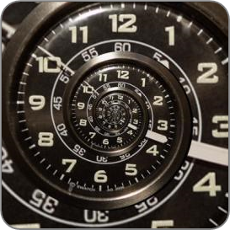
Time Complexity – Example
Sequential search in a list of size n
  Worst-case:
    n comparisons
  Best-case:
    1 comparison
  Average-case:
    n/2 comparisons
The algorithm runs in linear time
  Linear number of operations
… | … | … | … | … | … | …
n

Slide 15
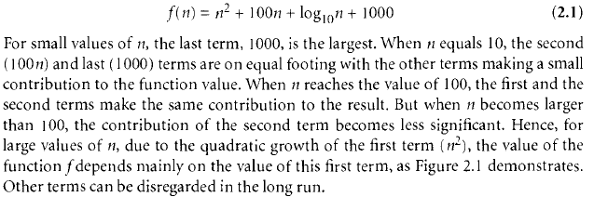
Asymptotic complexity
A function giving approximate measure of efficiency of original function for large quantities of data.

Slide 16
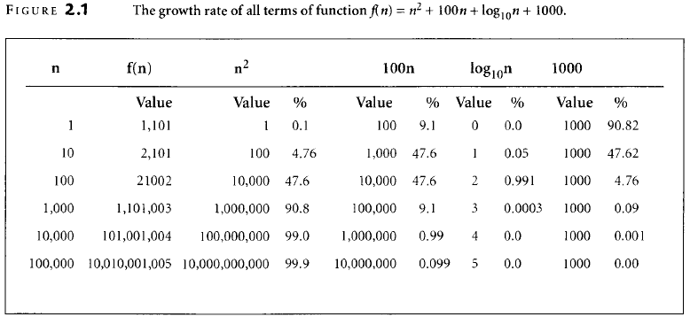

Slide 17
Algorithms Complexity
Algorithm complexity is rough estimation of the number of steps performed by given computation depending on the size of the input data
  Measured through asymptotic notation
    O(g) where g is a function of the input data size
  Examples:
    Linear complexity O(n) – all elements are processed once (or constant number of times)
    Quadratic complexity O(n²) – each of the elements is processed two times

